Slide 1
Housing Residence Education
Network and Services

Slide 2
Network Traffic
Student and Employee Internet traffic
Student and Employee door Key Card Lock System
Employee Phone System, Voice over IP
Employee Services
Monitoring and Control Systems

Slide 3
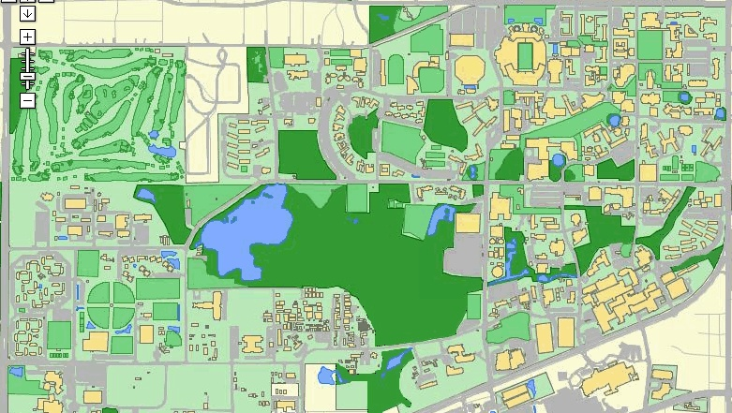
Other Student Affairs Departments HRE Supports
Vice President Office
Dean of Students Office
Off Campus Life
Multicultural Affairs
Student Legal Services
RecSports
Counseling Center

Slide 4
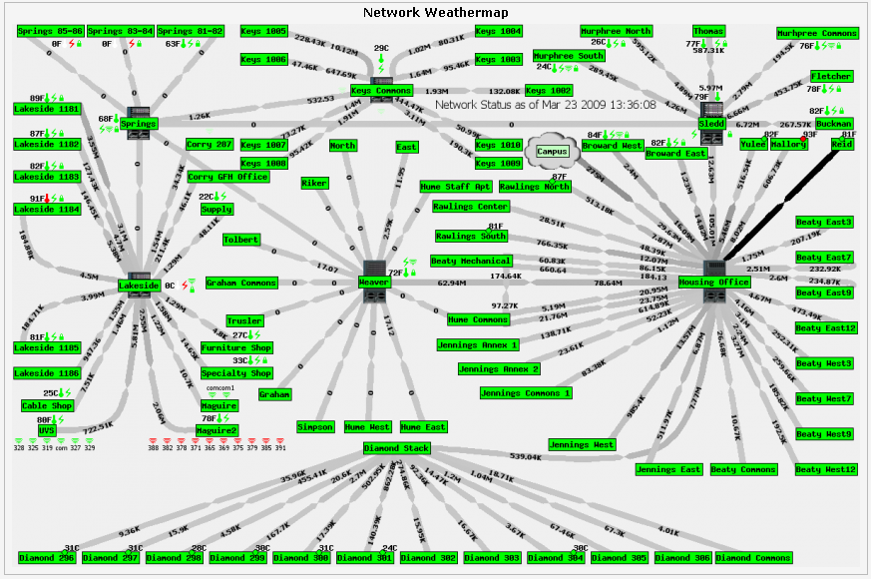
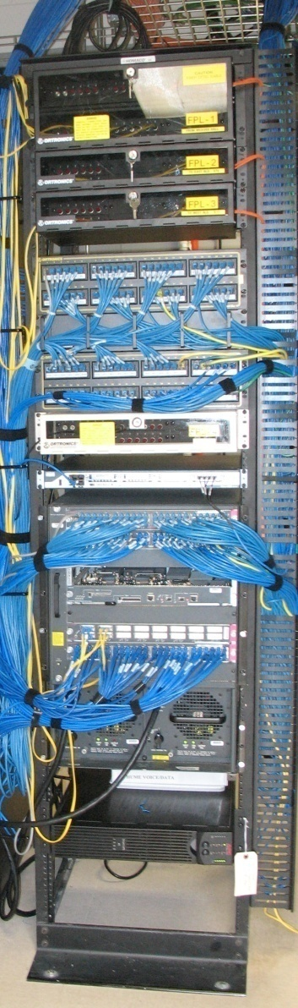
Network

Slide 5
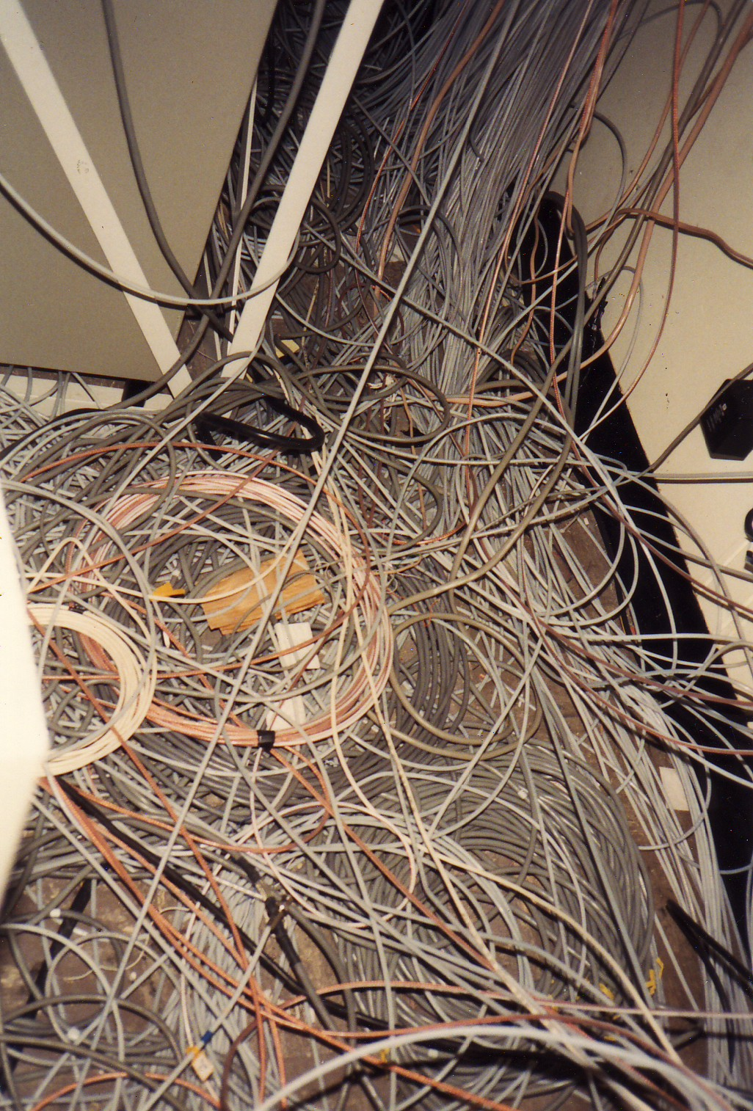
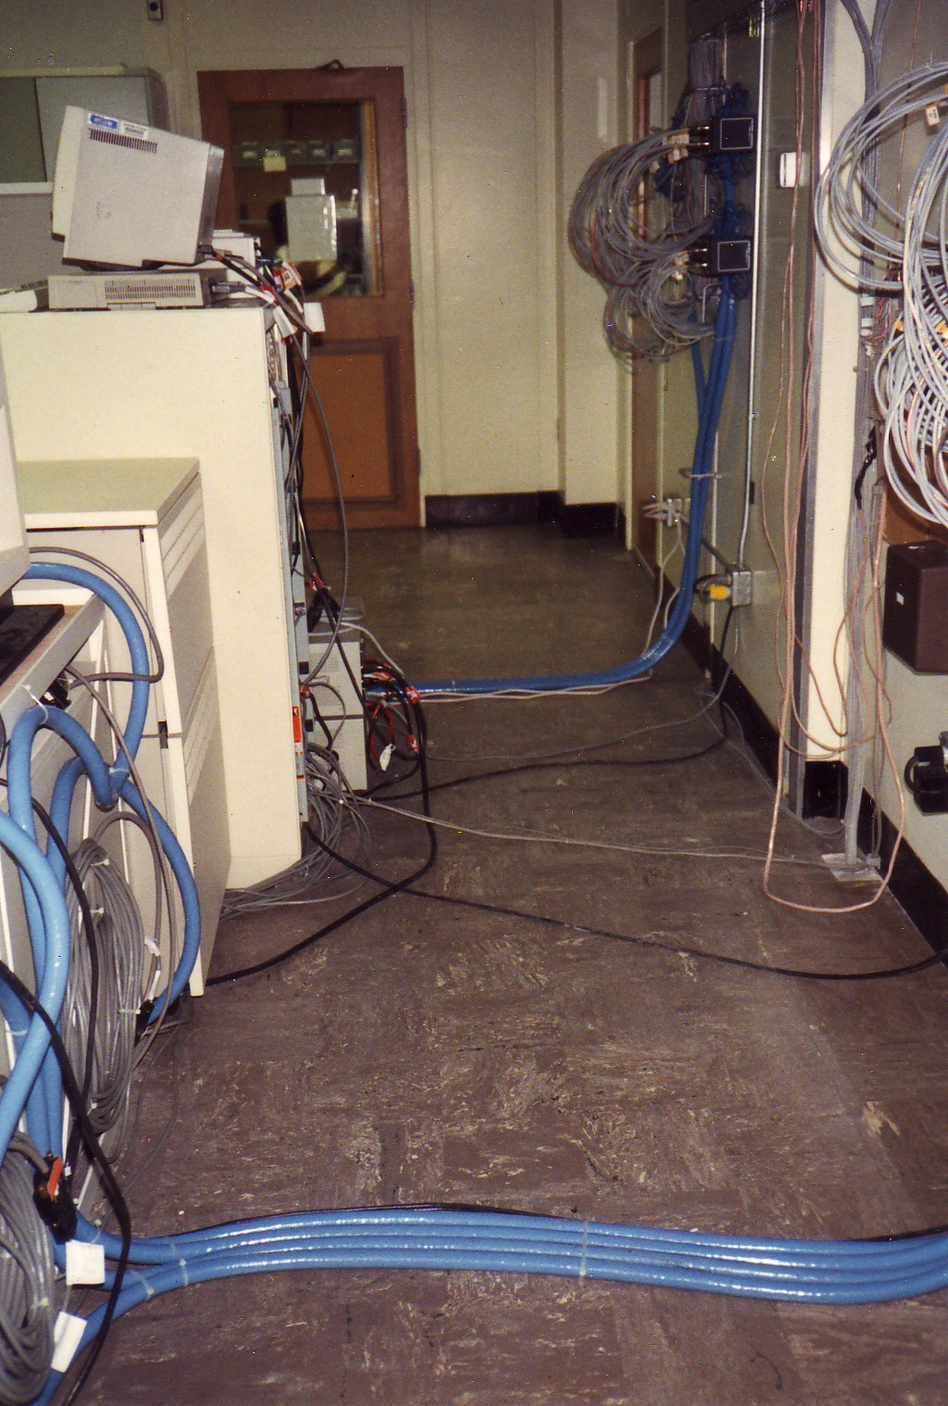

Slide 6
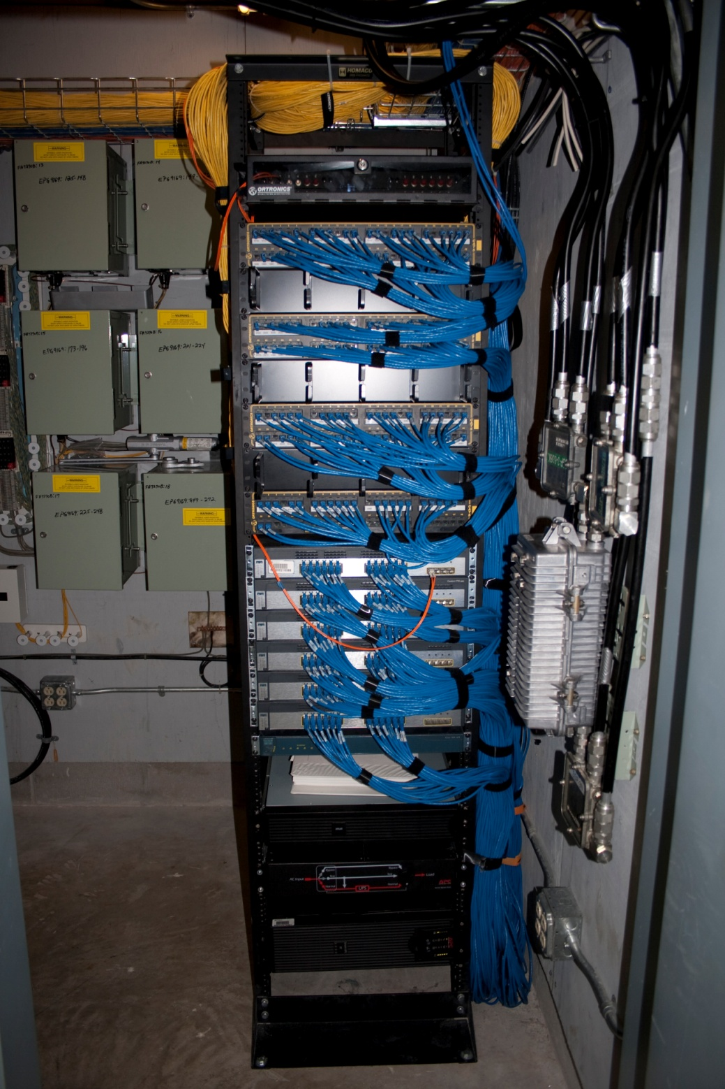
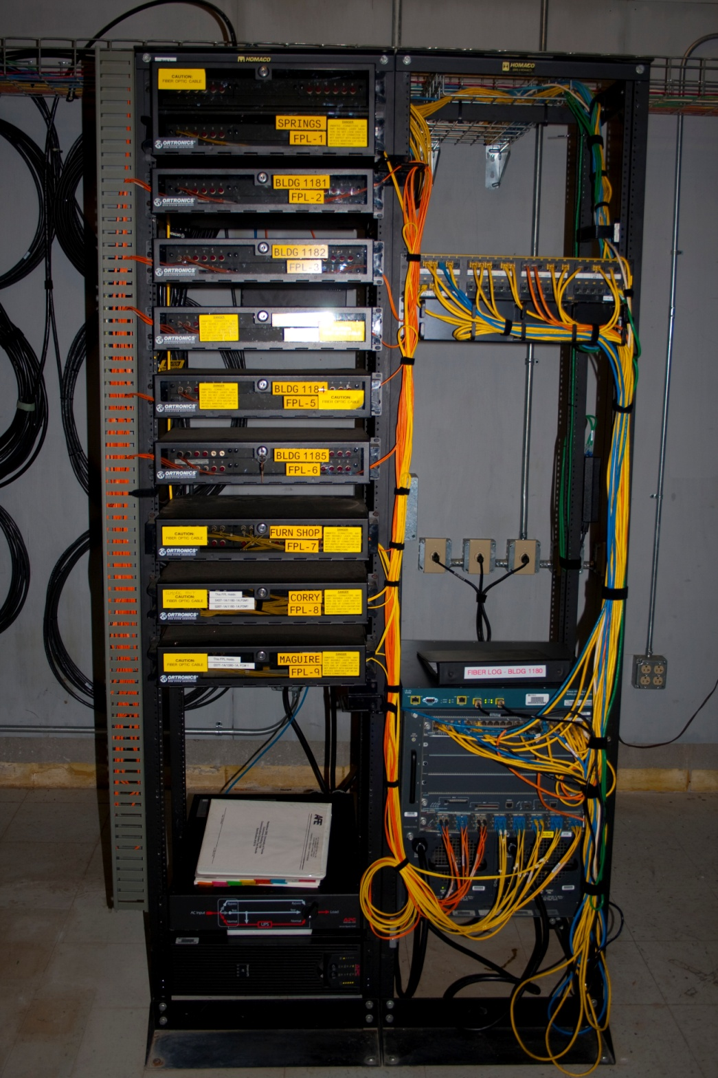

Slide 7
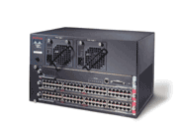

Network Ethernet
One Ethernet port per student in Residence Halls
Catalyst Switches with sup720 (12.2(18) switch 8.5(8))
  6515 – 5
  6509 – 13
  6506 – 13
  3750, 3550 -57
Every Ethernet Port is:
  10/100/1000 capable but configured for 10/100
  PoE (Cisco pre-standard PoE) and 802.3af
Notes:
• 24 Residence Halls
• 162 Total Housing Buildings
• 2.8 Million Square Feet
• 8,500 Housing Residents
• 5,300 New Residents Each Year
• Over 10,000 Wired Ports

Slide 8
Network Ethernet
(cont.)
Residence Halls Ports:
  802.1x
  DHCP Snooping
Roadmap
  Upgrade Catalyst switches from Cat OS to IOS (12.2(33)SXH3a)
  Add QoS

Slide 9
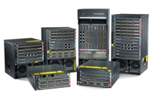

Network Backbone
Fiber between buildings
OSPF is the routing protocol
Single connection to UF Backbone OSPF ASBR
Roadmap
  Add 2nd connection to Backbone
  Add QoS
  Upgrade bandwidth to 10 gig

Slide 10
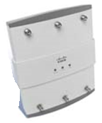
Network Wireless
Currently Wireless in:
  Residence Halls (1232, 1252 - 204)
  Maguire / UVS (1510, 1310 - 37)
802.1x Authentication and Encryption
  dhw (PEAP MSCHAP v2)
  dhwInstructions
Wireless Controller (4402 and WiSM – 2 each)

Slide 11
Disaster Recovery
BRP Facility (Hume)
UPS
Generators
LeftHand Networks SANs (IQ8.0)
Backups (Tivoli)
Waterford Tech MailMeter Archive
  Individual
  Investigate
Shadow Copy (files)
Notes:
BRP: Business Resumption Plan Facility
UPS: MOH 40 kVA, BRP 20 kVA on maintenance, battery replacement 4 per year
Generator: Hume generator is 35 kVA and is just for BRP room, MHO generator is 100 kVA and is for server room and emergency power within MHO. Generators run on natural gas.
SANs: 6 modules (3 in MHO, 3 in Hume). Each module is HP DL320, 2.4 GHz Xeon, 2 GB RAM, 3.6 TB storage

Slide 12
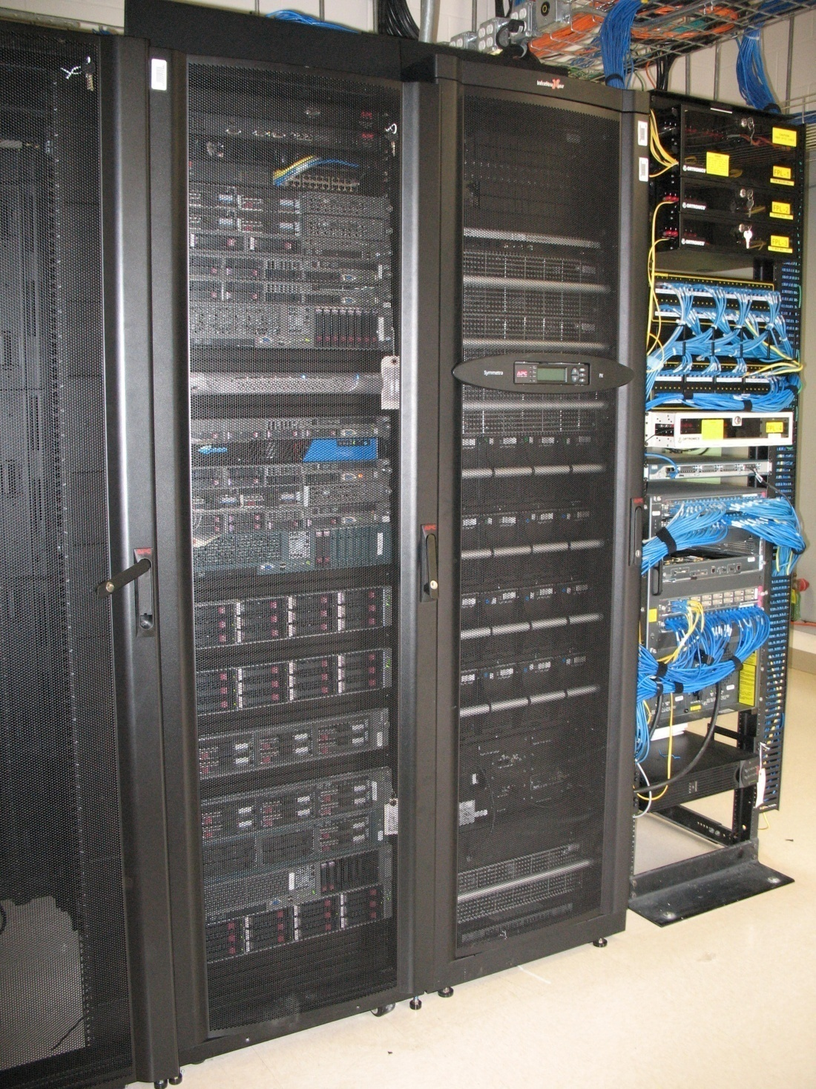
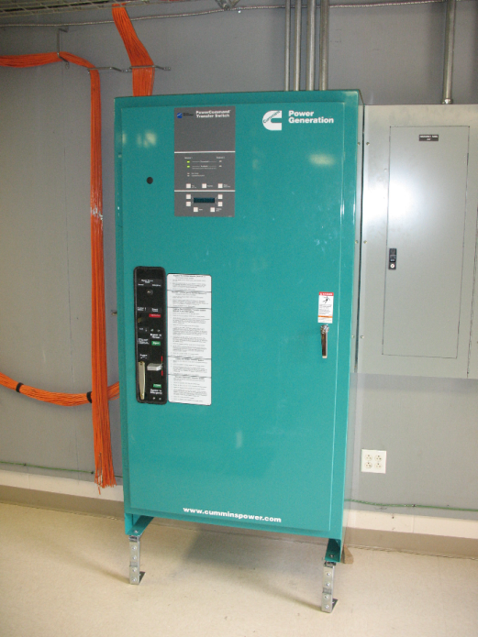
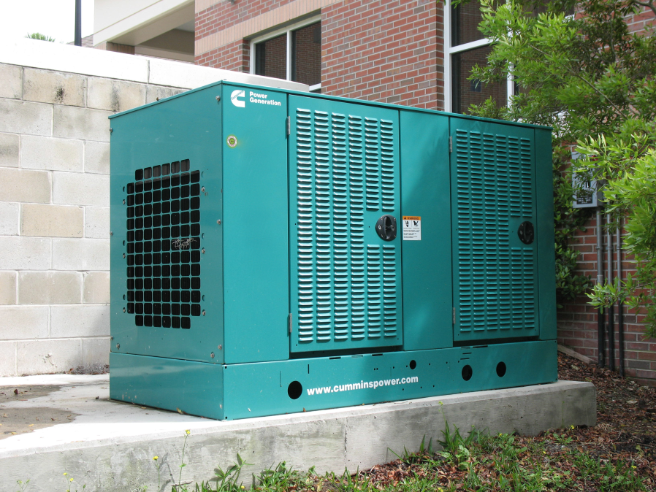
Notes:
Hume generator is 35 kVA and is just for BRP room, MHO generator is 100 kVA and is for server room and emergency power within MHO. Generators run on natural gas. Transfer switch feed from commercial power and generator.

Slide 13
Network Services
Redundant DHCP (ISC-DHCPD 3.0.5)
Redundant DNS
Redundant Active Directory (2003)
Redundant ACS (4.1)
Redundant RADIUS (FreeBSD 7.0, FreeRadius 2.0)
Redundant MySQL (FreeBSD 7.0 MySQL 5.0.67)
Redundant SQL (Windows 2003 Server SQL 2005)

Slide 14
Network Security
Ethernet and Wireless 802.1x authentication
McAfee Endpoint Encryption (3.1.0.5)
McAfee Anti-Virus (8.7)
McAfee Anti-Spyware (8.7)
Diskeeper (2008 Professional)
ACL and FWSM
SPAM
  Redundant Barracuda 400 SPAM filter
  SpamAssassin (3.2.5)

Slide 15
Authentication
802.1x
Is an IEEE standard for port based authentication
Provides for encryption of credentials
Consists of three components
  Supplicant - Software in computer’s OS
  Authentication Server - RADIUS server
  Authenticator - Cisco network switches

Slide 16
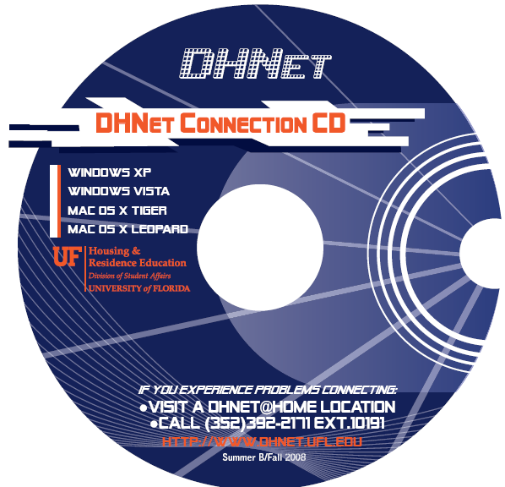
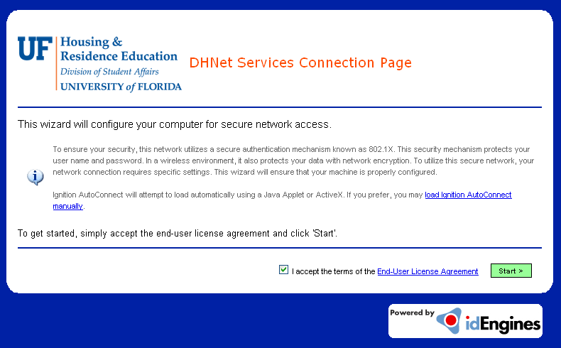
Authentication
Supplicant Solution
Program called XpressConnect from
Cloudpath:
Configures supplicant
Scans for programs; conflicting, P2P
Available:
CD
Webpage

Slide 17
Authentication
802.1x (cont.)
Supplicant
Authenticator
Authentication
Server
802.1x
Radius
User Connects Computer
Identity Request
Uncontrolled
Port
Identity Response
Authentication to Server
Authentication to Server
Port authorized - access VLAN
Port Fail - fail VLAN
Authentication Successful / Rejected
Data VLAN
Notes:
Uncontrolled port only allows EAPOL, Extensible Authentication Protocol Over Lan

Slide 18
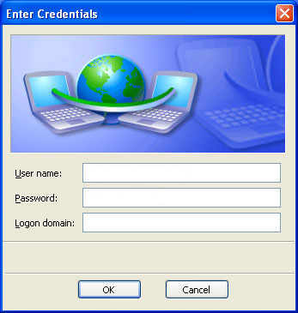
Authentication
Authentication Server (cont.)
My SQL
HRE AD
UF AD
User Name
Password
Domain
Radius
Domain Equals:
Global
Guest
Conference
UFAD
Global
Local DB
Other
Empty

Slide 19
VLANs
Ethernet
Student VLAN = Authenticated
VLAN 30X
Restricted VLAN = P2P Detected
VLAN 321
Fail VLAN = Failed to Authenticated
VLAN 40X
Instructions VLAN = Wireless Configure Supplicant
VLAN 502

Slide 20
Sample Switch Configuration
802.1x on IOS
dot1x
dot1x system-auth-control
!
interface
switchport access vlan 301
switchport mode access
dot1x pae authenticator
dot1x port-control auto
dot1x auth-fail vlan 401

Slide 21
Sample Switch Configuration
AAA and Radius on IOS
aaa new-model
aaa authentication dot1x default group radius
aaa authorization network default group radius
aaa accounting dot1x default start-stop group radius
!
radius-server attribute nas-port format b
radius-server host 10.2.1.133 auth-port 1812 acct-port 1813 key xxxx
radius-server host 10.2.1.123 auth-port 1812 acct-port 1813 key xxxx
radius-server vsa send accounting
radius-server vsa send authentication
Notes:
Radius vsa
Vendor-Specific Attributes
VSAs are available to allow vendors to support their own proprietary attributes that are not covered by RFC 2138. IAS includes VSAs from a number of vendors in its multivendor dictionary. However, this list evolves over time and new attributes and vendors are always being added.
The aaa authorization network default group radius command is for dynamic VLAN assignment

Slide 22
Sample Switch Configuration
VLAN and Interface on IOS
vlan 301 (301 – 30X)
name Student301
vlan 321
name RESTRICTED
vlan 401 (401 – 40X)
name Failed401
vlan 502
name Instruction502
!
interface GigabitEthernet1/0/1
switchport access vlan 301
switchport mode access
dot1x auth-fail vlan 401
Notes:
The dot1x pae authenticator commands enables the authenticator functionality on this interface
The dot1x port-control auto command enable dot1x on this interface, to disable force-authorized.

Slide 23

Authentication and VLANs
Student VLAN
Ethernet
VLAN 30X
Authenticated

Slide 24
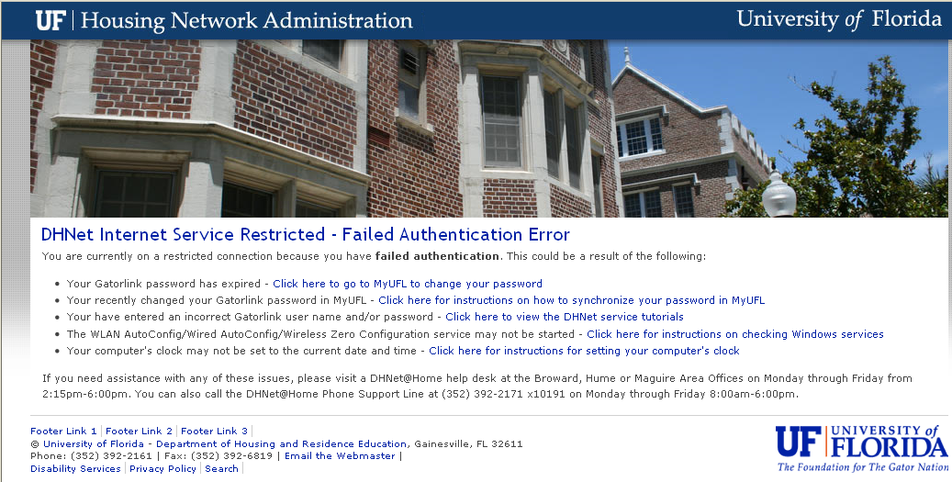
Authentication and VLANs (cont.)
Fail VLAN
Ethernet
VLAN 40X
Failed to Authenticate

Slide 25
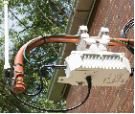
Authentication and VLANs (cont.)
Instructions VLAN
Ethernet
VLAN 502
Configure Wireless Supplicant
SSID dhwInstructions

Slide 26
Network Security
(cont.)
  WebSense WebFilter (7.0.1)
  Audible Magic CopySense (4.1)
  Identity Finder Enterprise, DB and Web search
  Tenable Nessus (3.2.1) with Nessquik
  SourceFire 3500 IPS (4.8.0.3)
  Road Map:
    Add OSSEC HIDS for employee computers
    Add Cisco NAC for employee computers
Notes:
WebSense: HP DL360 G5, 4 Gig RAM, 2 Intel Xeon Dual-Core 3 GHz
ID Finder: VMware under Support3

Slide 27
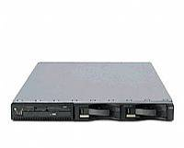
Detection
Spanning Port
1
2
Monitor Port
Control Port
CopySense Appliance
DHNet Program
Spanning Port sends all DHNet traffic to and from Internet to CopySense appliance.
2. CopySense generates reports:
  File Sharing (Seeding)
  Copyrighted
  Encrypted P2P
Notes:
DHNet Program written in Java 1.6

Slide 28
Action
DHNet Program
Query CopySense
Bounce / Re-authenticate Port
Query Radius
IP Address
Query DHCP
IP Address
MAC Address
Switch IP Address
Port ID
User Name
Create Case
IP Address
MAC Address
Query Device
Table
Add User to
Restricted Group
Send Email
Switch IP Address
Port ID
IP Address
MAC Address
Switch IP Address

Slide 29
Action
DHNet Program (cont.)
Query every 5 minutes
Query CopySense
IP of Violation
Copyright
File sharing
Encrypted P2P
IP Address
CopySense Appliance
Query DHCP
Query MAC of IP
DHCP Log
MAC Address
IP Address
MAC Address
Tables
Device
Subnet
Association
Query IP of Switch
Query Device
Table
My SQL
DHCP (Tailing)
Switch IP Address
IP Address
MAC Address
Switch IP Address
Notes:
MySQL 5.0
DHCP ISC

Slide 30
Action
DHNet Program (cont.)
Query Radius
Query
Accounting Startup
User name
Port ID
Table
radacct
Port ID
User Name
IP Address
MAC Address
Switch IP Address
Port ID
User Name
My SQL
User
Authenticates
Add User to
Restricted Group
User ID
Table
usergroup
Switch IP Address
Port ID

Slide 31
Action
DHNet Program (cont.)
Cat OS
Bounce / Re-authenticate Port
Cat OS Expect Script Sends
set port disable m/p
set port enable m/p
set port dot1x m/p re-authenticate
VLAN 321
VLAN 30X
IOS
Bounce / Re-authenticate Port
IOS Expect Script Sends
VLAN 30X
VLAN 321
interface
shut
no shut
dot1x reauthentication

Slide 32
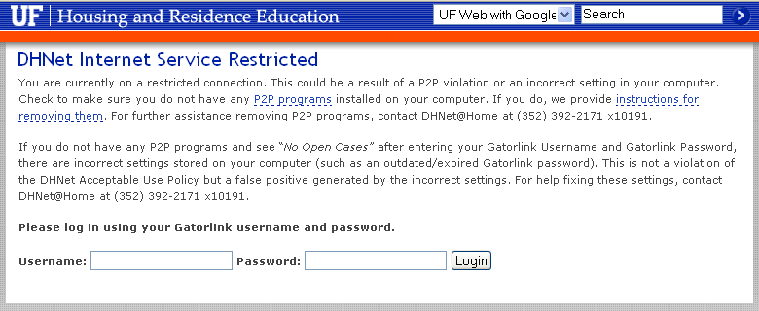
Authentication and VLANs (cont.)
Restricted VLAN
Ethernet
VLAN 321

Slide 33
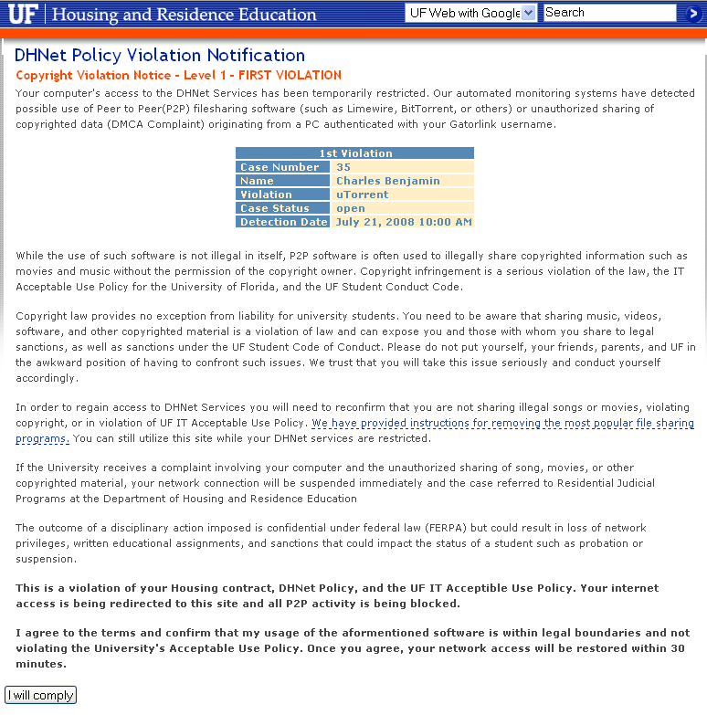
Remediation
Acceptable Use Policy Compliance
Case Number
Name
Violation
Status
Detection Date
Description
I will comply

Slide 34
Remediation
DHNet Program
Query Pending Cases
Query every 5 minutes
My SQL
Time > Range
no
yes
Remove User from Restricted Group
Bounce / Re-authenticate Port
VLAN 321
VLAN 30X

Slide 35

Student and Employee Card Lock System
Installed in all the Residence Halls
GE Diamond II Software
Magnetic and Proximity Card Readers - 408
ACU (Access Control Units) - 128
Notes:
Newdiamon2, HP DL380 G4, 3 Gig RAM, 2 Intel Xeon Dual-Core 3.2 GHz

Slide 36
Employee Phone System
Voice over IP
VoIP PBX, Cisco CallManager
  Publisher (4.1(3)sr5d)
  Subscriber redundant load sharing
  Phones (7960 / 7961 / 7940 / 7941 / 7921 / 7914 / 7936) – 460
  SCCP
  IP Communicator
  Attendant Console
Gateway
  T1 Blade in Catalyst, MGCP
Notes:
CallManager: MCS 7835
SCCP: Skinny Client Control Protocol
MGCP: Media Gateway Control Protocol

Slide 37
Employee Phone System
Voice over IP (cont.)
Voicemail
  Cisco UNITY (5.0(1))
  Redundant hot spare
  Auto Attendant
  Check voicemail from phone or Outlook
Notes:
UNITY servers: MCS 7835, 2GB, Windows 2003

Slide 38
Employee Services
VMware ESX (3.5 U2) – 21 services
Microsoft Exchange 2003 and Webmail
File and Print Services
Microsoft Office SharePoint (2007)
Design Positive FlashPageFlip
RIM Blackberry (4.1)
Simplicity Judicial Affairs Management System
Notes:
VMware Cluster: 4 servers HP DL380 G5, 20 Gig RAM, 2 Intel Xeon Dual-Core 3.2 GHz
Exchange: Redundant frontends, HP DL360 G5, 4 Gig RAM, 2 Intel Xeon Dual-Core 3.2 GHz
File: Redundant cluster, HP DL360 G5, 4 Gig RAM, 2 Intel Xeon Dual-Core 3.2 GHz
Others: SharePoint, FPF, Blackberry and JAMS runs on VMware cluster

Slide 39
Employee Services
(cont.)
Windows Mobile Active Sync
OpenFire (3.6.3) with Spark
PHPLive Chat Support (3.1)
Microsoft Configuration Manger (2007)
McAfee EPolicy Orchestrator (4.0)
TMASystems Maintenance Management

Slide 40
Employee Services
Web Hosting
Apache 2 or IIS (6.0 and 7.0)
Portal support, Jboss (4.3) and JetSpeed (1.6)
Web Sites
DHNet Website www.dhnet.ufl.edu
RecSports Website – www.recsports.ufl.edu
Reitz Scholars – www.reitzscholars.ufl.edu
Mayor’s Council Website mayorscouncil.housing.ufl.edu
Dean of Students Office Website – www.dso.ufl.edu

Slide 41
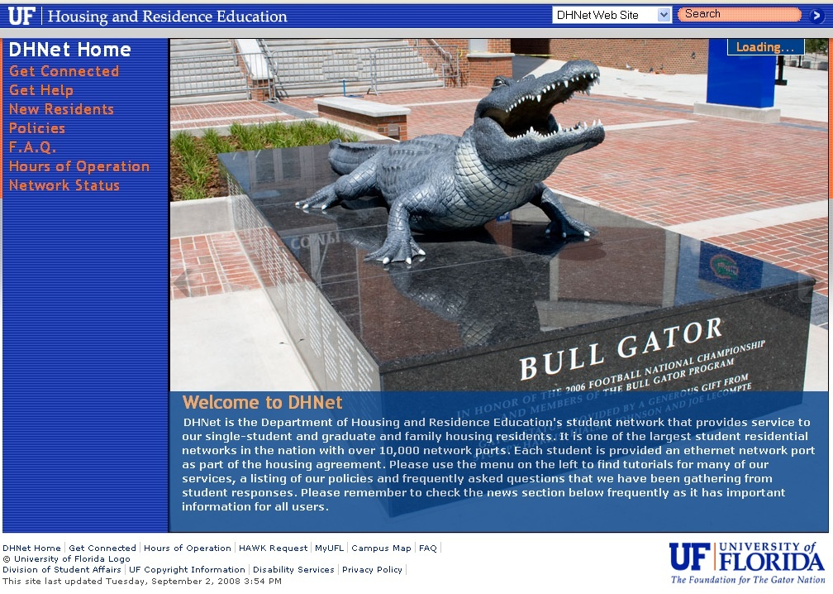
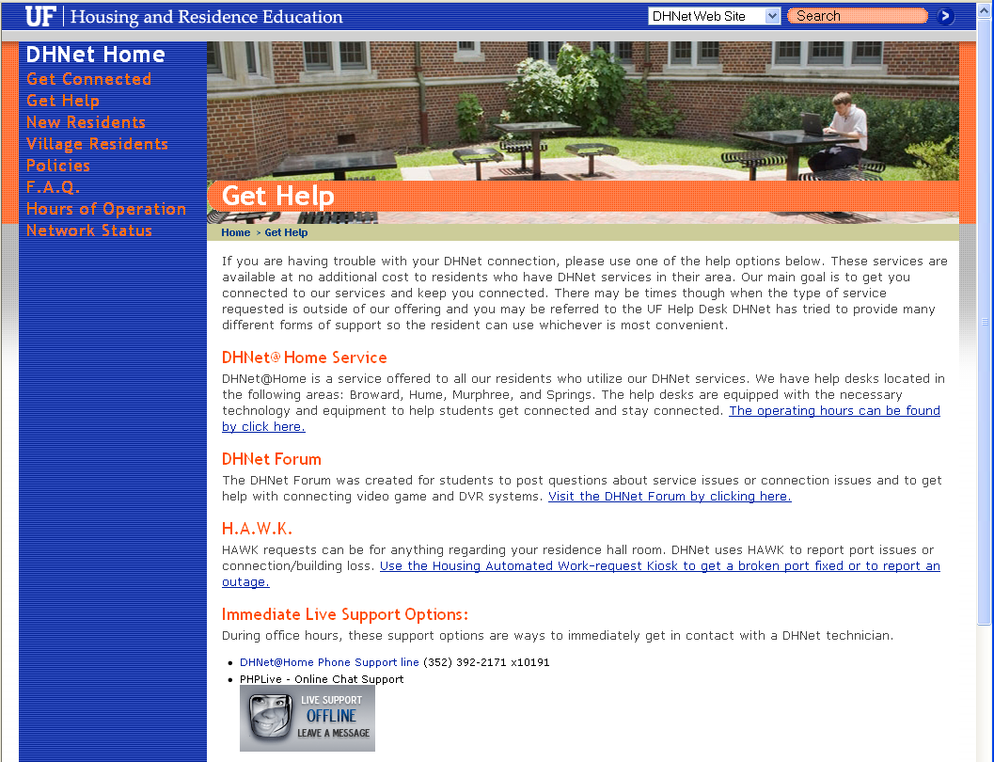
DHNet Home Page

Slide 42

RecSports Home Page

Slide 43
Monitoring and Control Systems
CiscoWorks (3.0)
Cacti
VMware Infrastructure
TMA Trouble ticket system
WCS (Wireless Control System)
WLC (Wireless LAN Controller)
P2P Monitoring, CopySense and DHNet Program
Automated Logic WebCTRL
APC InfraStruXure Manager

Slide 44
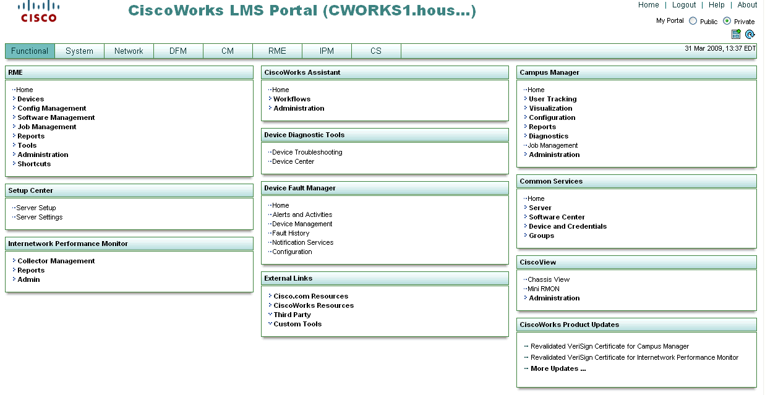
CiscoWorks

Slide 45
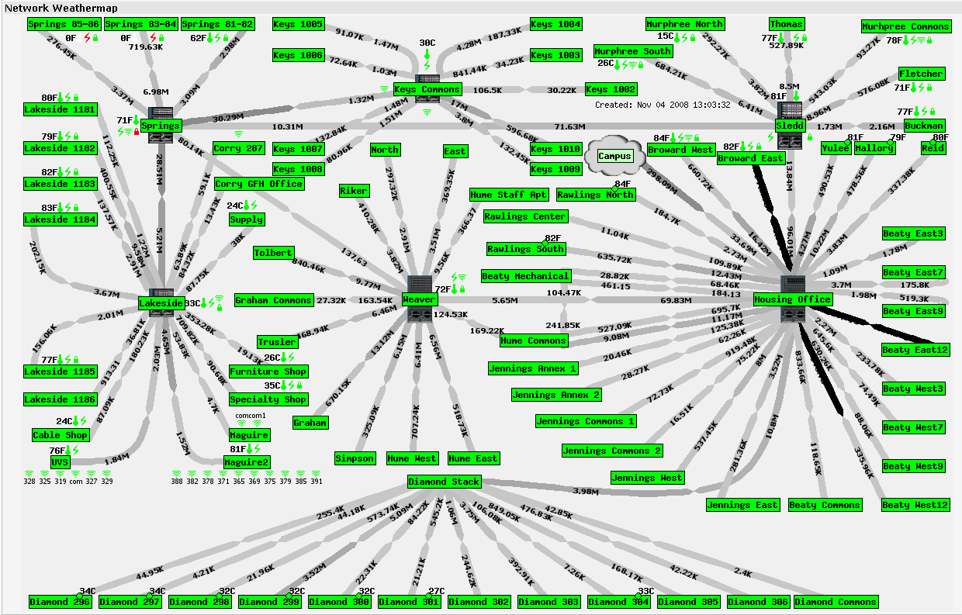
Cacti

Slide 46
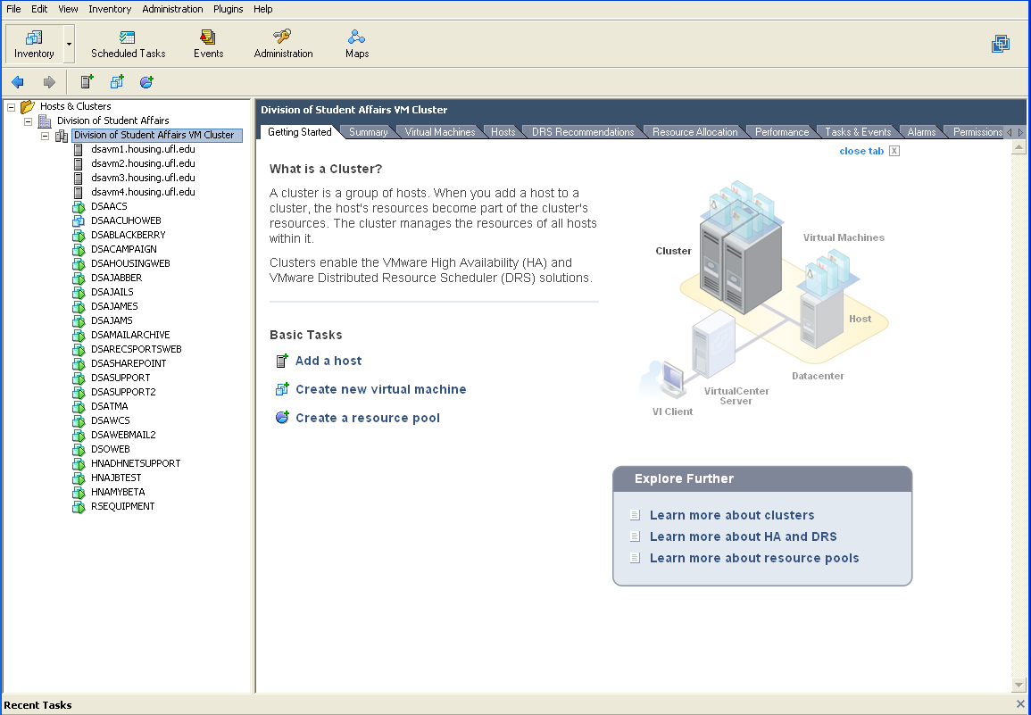
VMware Infrastructure

Slide 47
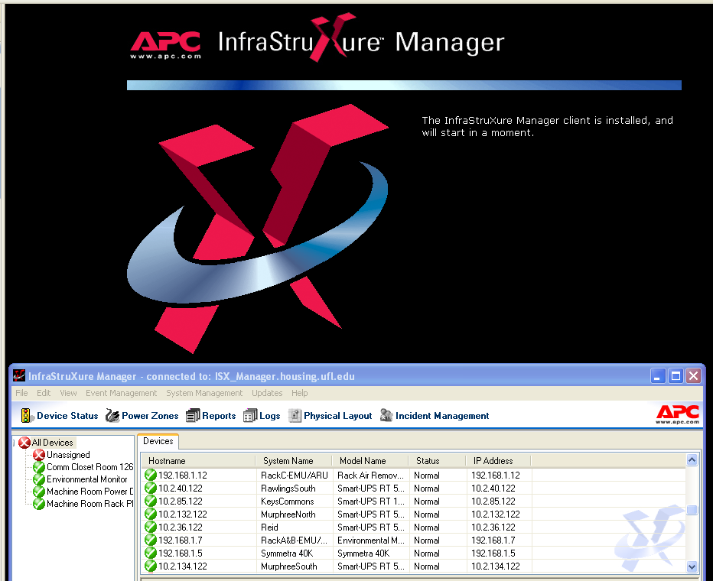
APC InfraStruXure Manager

Slide 48
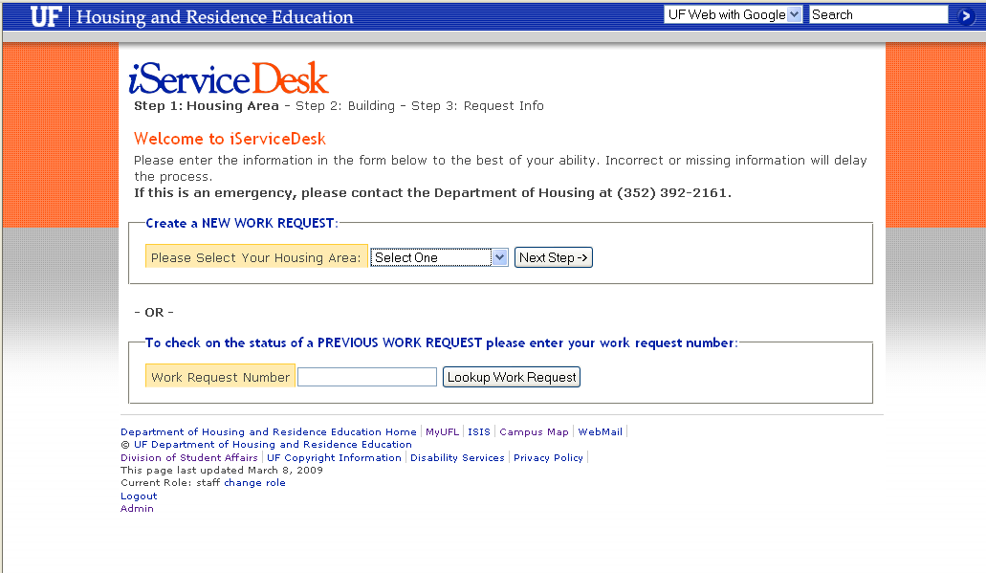
Trouble Ticket

Slide 49
Trouble Tickets
Month | # Opened | # Closed | Avg Opened/Day | Avg Closed/Day | Avg Time to Close
Jan-09 | 198 | 197 | 9.43 | 9.38 | 4.64
Feb-09 | 207 | 196 | 10.89 | 10.32 | 3.67
Mar-09 | 45 | 58 | 7.50 | 9.67 | 1.39

Slide 50
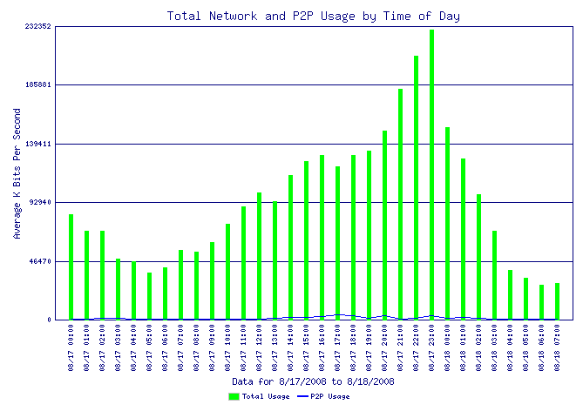
Reports
Bandwidth (First 24 hours)

Slide 51
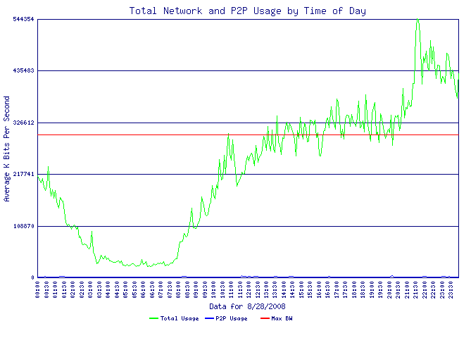
Reports
Bandwidth (2nd week, 24 hours)

Slide 52
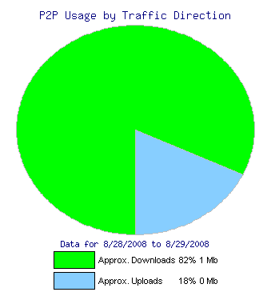
Reports
P2P by Direction (2nd week, 24 hours)

Slide 53
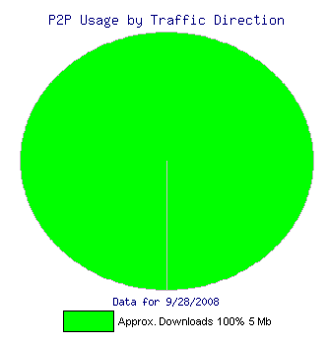
Reports
P2P by Direction (8th week, 24 hours)

Slide 54
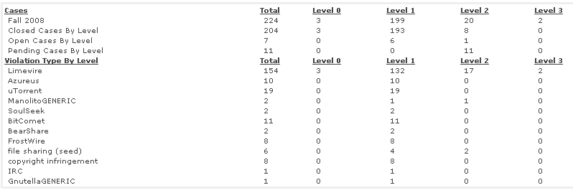
Reports
Case Data (1st week)

Slide 55
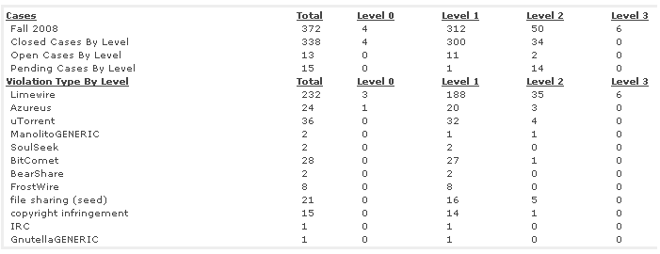
Reports
Case Data (4th week)

Slide 56
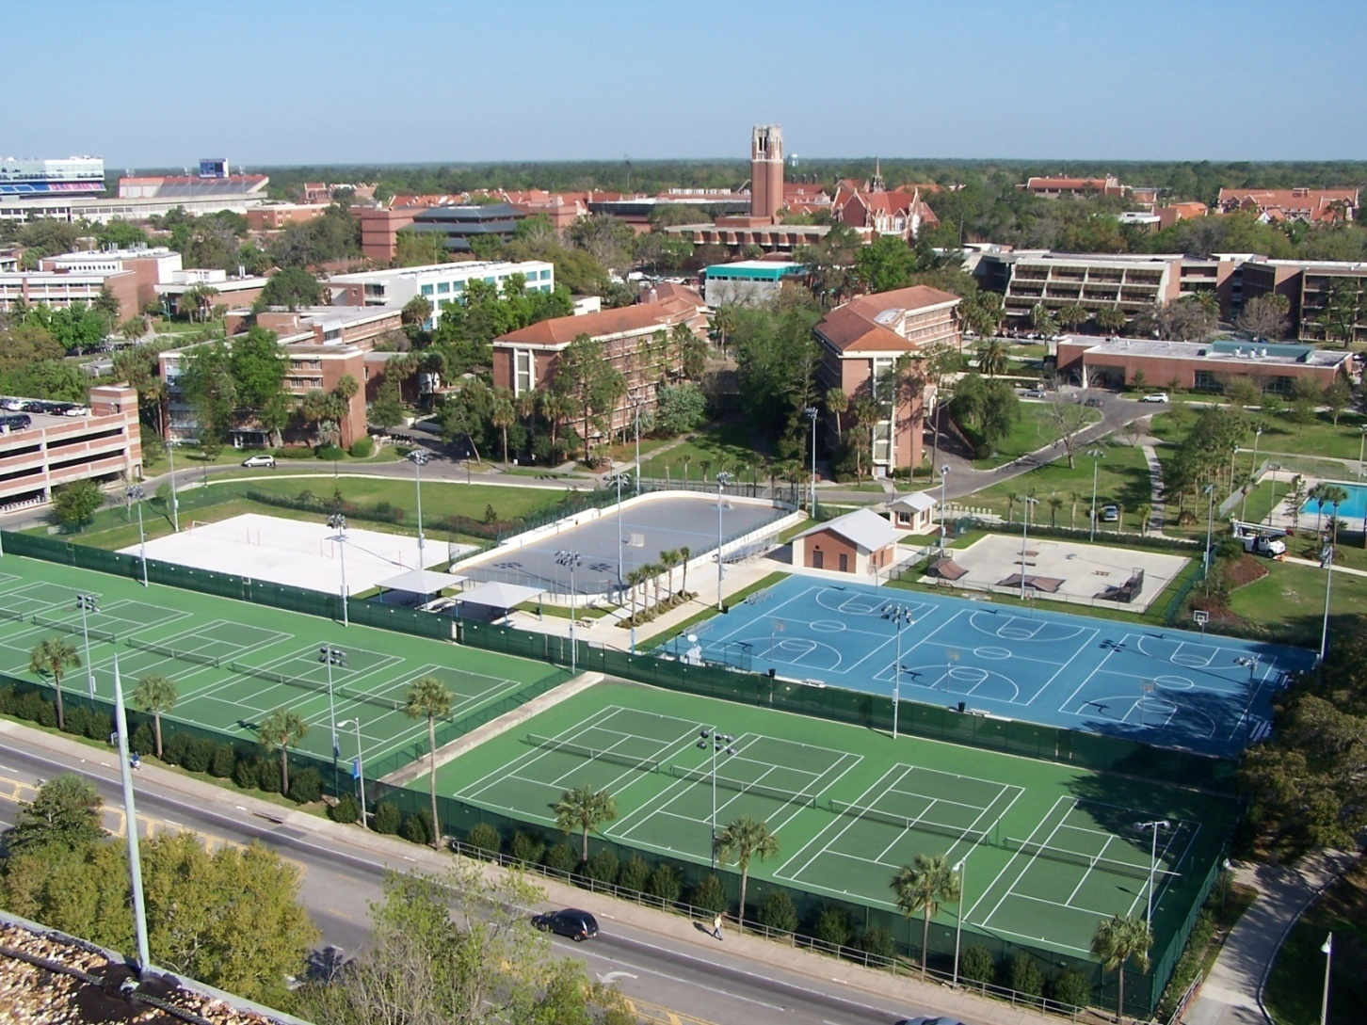
Thank you

