Slide 1
Network Security
Department of Housing and Resident Education
Charles Benjamin

Slide 2
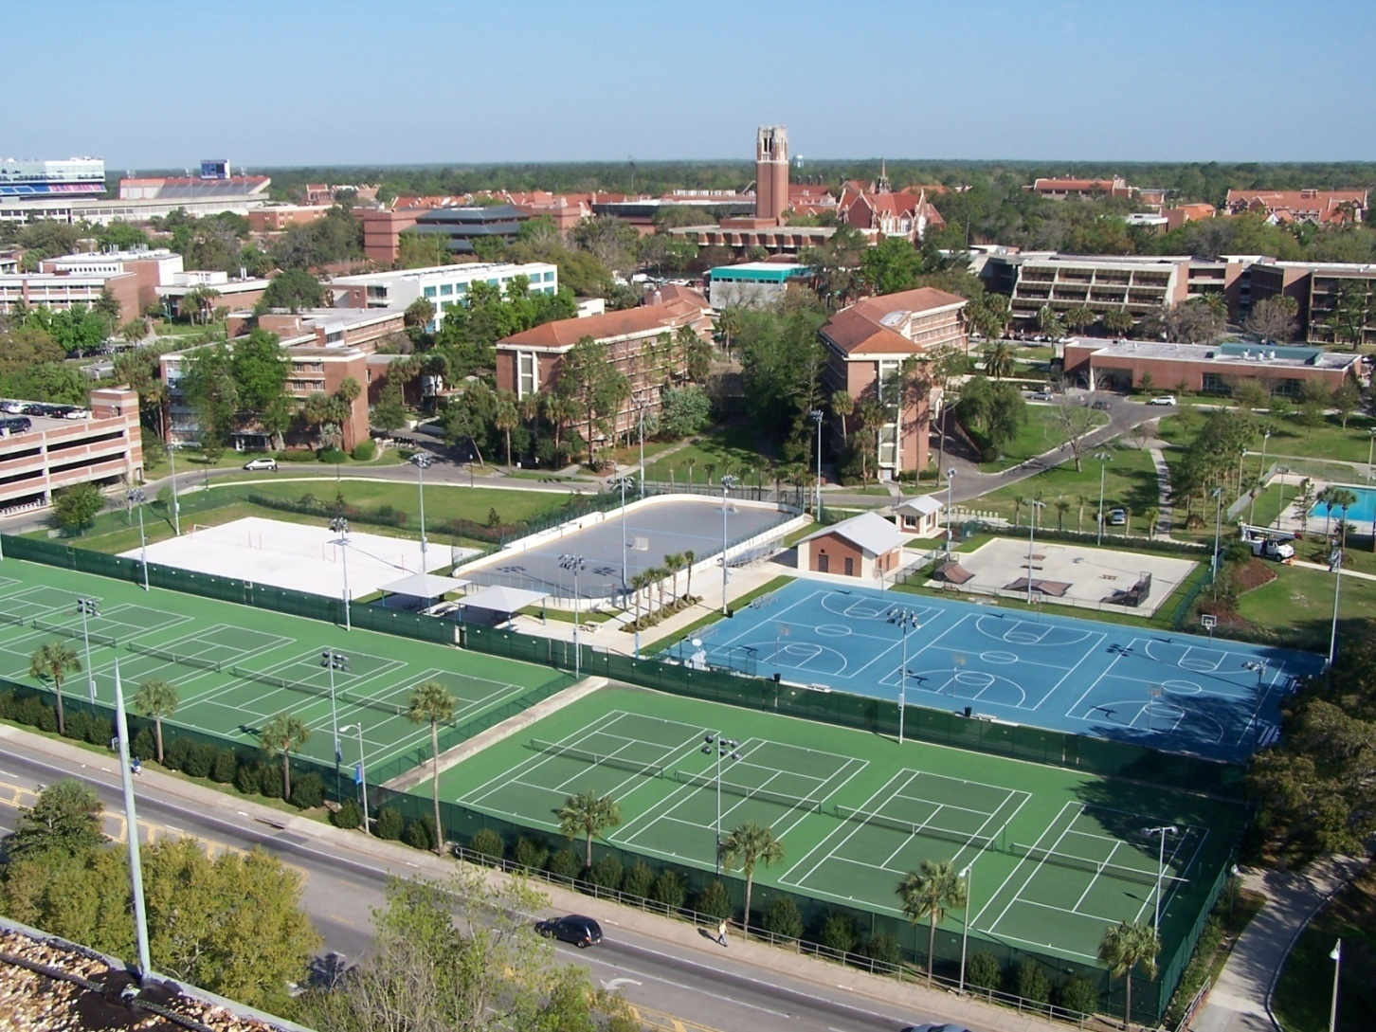
Resident Housing at UF
Notes:
45 Under graduate buildings (Beaty 14 stories)
44 Maguire / UVS

Slide 3
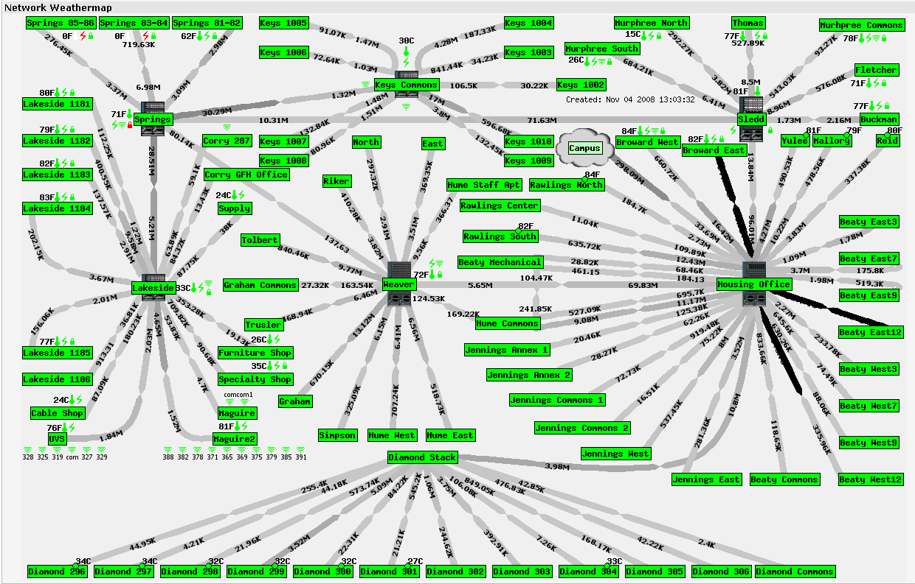
The Housing Network
Notes:
90,000 feet of fiber sheath 12 – 48 count
90 Switches 1/3 Catalyst 6500

Slide 4
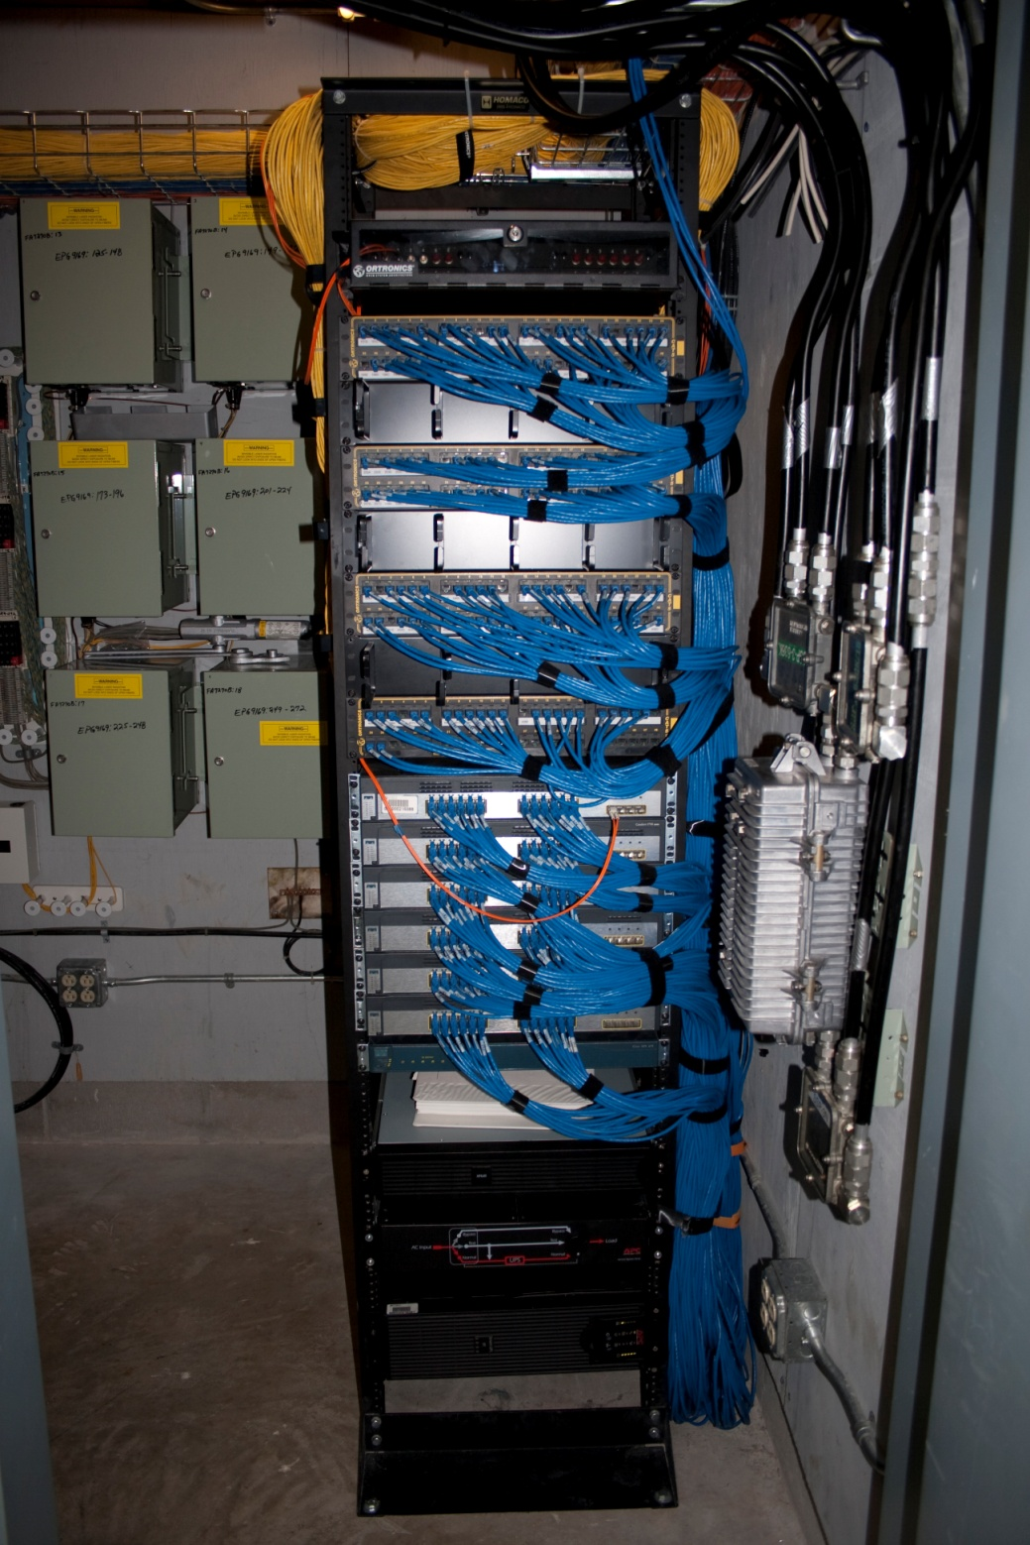
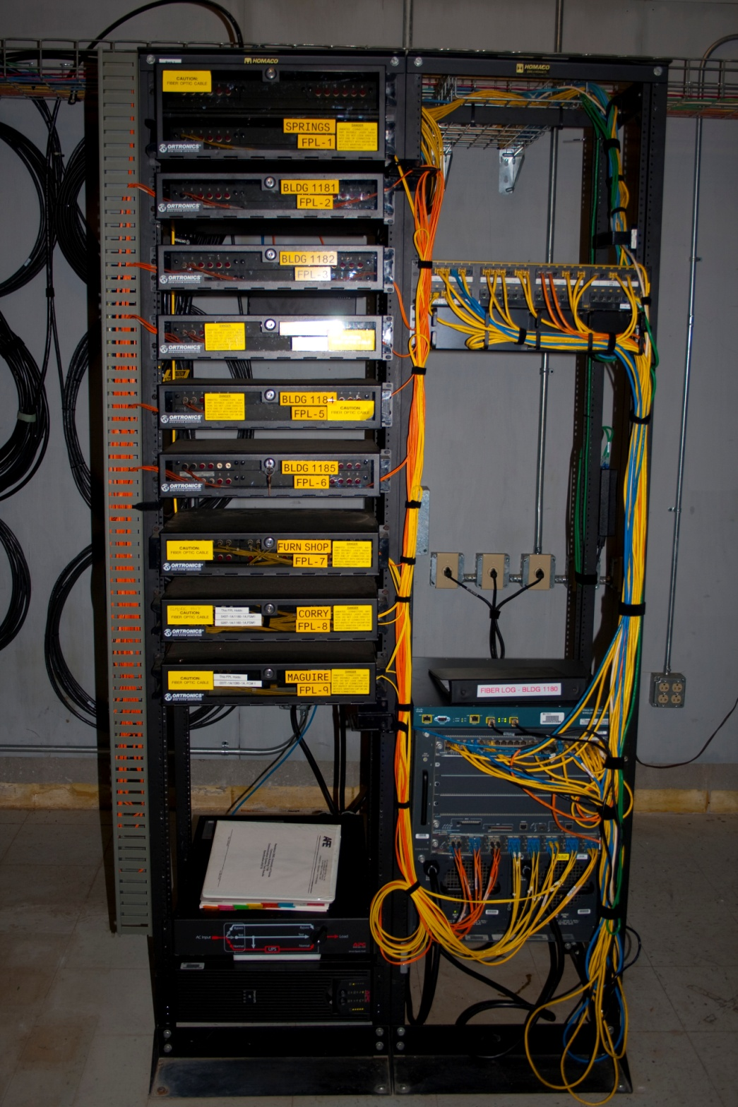

Slide 5
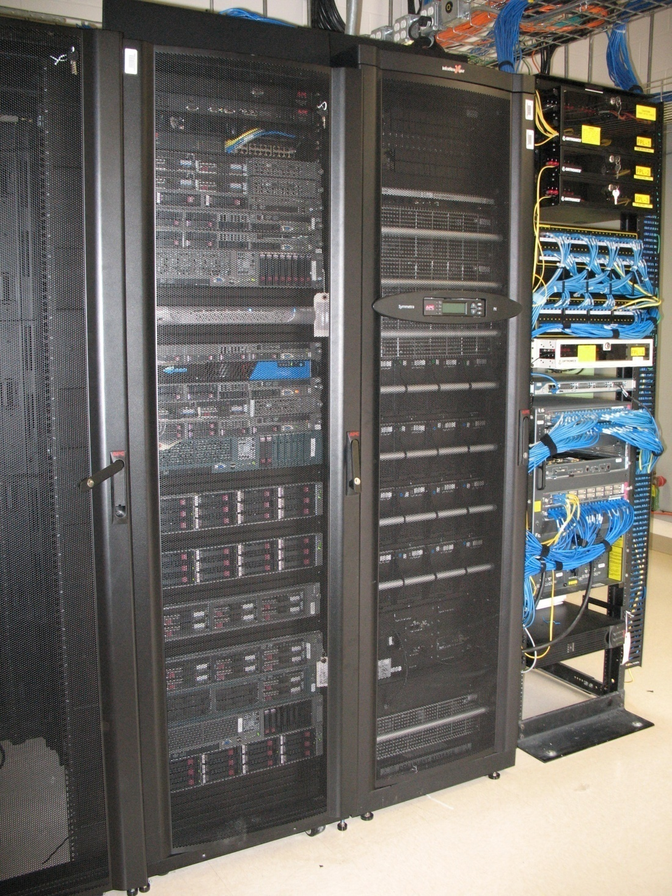
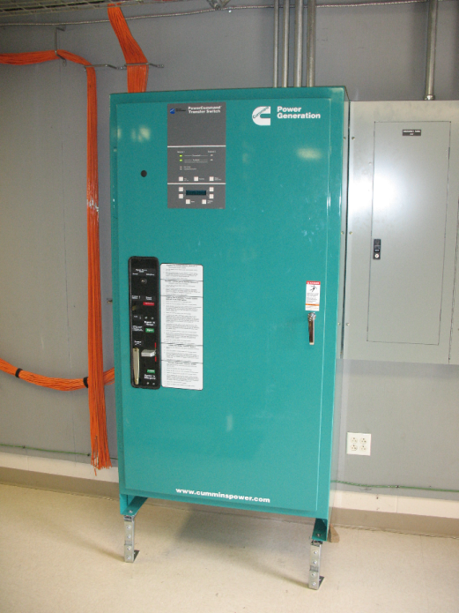
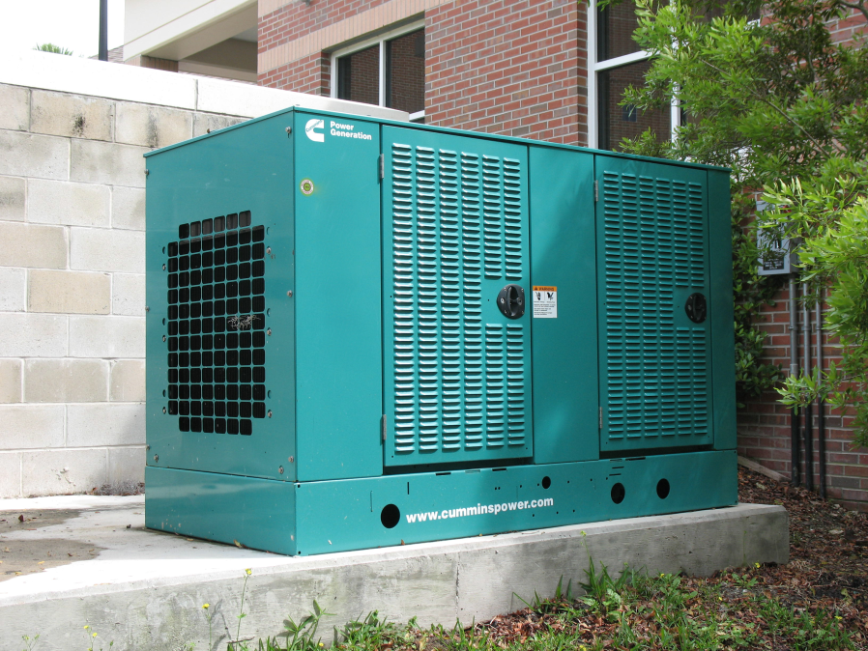
Notes:
Hume generator is 35 kVA and is just for BRP room, MHO generator is 100 kVA and is for server room and emergency power within MHO. Generators run on natural gas. Transfer switch feed from commercial power and generator.

Slide 6
Network Security
Change network from flat to routed
Installed FWSM
Installed 802.1X on Ethernet
Started using XpressConnect from Cloudpath
Installed CopySense from Audible Magic

Slide 7
Network Security
  Add Wireless
    PEAP MSCHAP v2
    241 Wireless Access Points ( adding 105)
    4 WISMs
Configured 802.1X to Wireless
  Installed SourceFire 3500 IDS
  Added NOC
Installed StealthWatch from Lancope

Slide 8
Computer Security
  Employee Computers
    Installed Web Filter Websense
    Installed and run Identity Finder
    Installed VIPRE Antivirus
Student Computers
  NAC SafeConnect from Impulse

Slide 9
Network Access Control
Evaluation
Cisco
Bradford Networks
Impulse SafeConnect
  KIS
  Components
  Cost
  Function
  Other Installation
  Florida

Slide 10
Impulse SafeConnect
Components
Policy Enforcer appliance (PE)
  DB – MySQL, Webserver – Tomcat, Proxy – Squid
Management Console
Reporting Console
Policy Key
  Lite weight program 1.27 M
Router configuration
Authentication Server

Slide 11
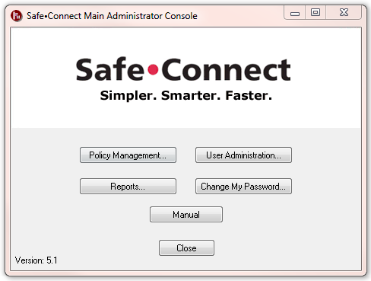
Management Console

Slide 12
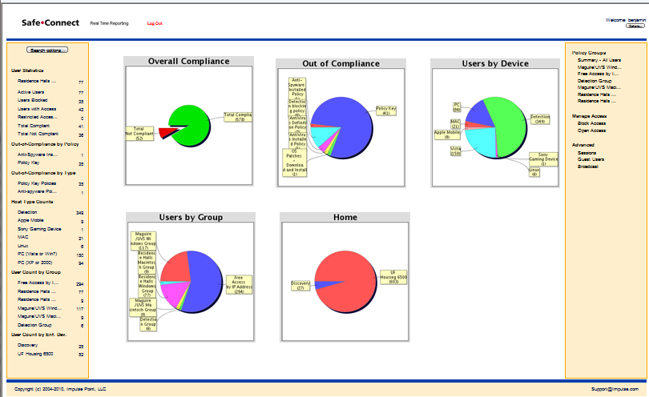
Reporting Console

Slide 13
Impulse SafeConnect
Setup
Configure Housing Border Router
  NetFlow
  Policy Based Routing
  SSH connection
Install Policy Enforcer Appliance
Configure Authentication Server
  RADIUS
Configure Policy Groups, Management Console
  Device Type
  Location

Slide 14
Impulse SafeConnect
Example of Windows Policy
Policy Key
P2P
Anti-virus
OS updates
Anti-spyware

Slide 15
Impulse SafeConnect
Go Live with Housing NAC
Implemented in phases:
  Internal
  Summer A 2010
    570 students
  Summer B 2010
    2,680 + 350 = 3,030 students
  Fall 2010
    7,530 + 350 = 7,880 students

Slide 16
Impulse SafeConnect
Installing Policy Key
DHNet CD, XpressConnect
On wireless dhwInstructions DHNet webpage, XpressConnect
From SafeConnect Policy Enforcer (PE)

Slide 17
Impulse SafeConnect
Connection Process
Student runs XpressConnect via
  DHNet CD
  Wireless SSID dhwInstructions
XpressConnect
  Configures 802.1X Supplicant
  Install SafeConnect Policy Key
RADIUS server sends accounting to PE
  IP, MAC, Username

Slide 18
Impulse SafeConnect
Connection Process (cont.)
Student connects to Housing network
Router send NetFlow information to PE
PE compares data from RADIUS and Policy Groups configured in PE
Items in the Group Policy are processed from top down

Slide 19
Impulse SafeConnect
Connection Process (cont.)
If the Policy Item specifies Quarantine
  PE sends Policy Based Routing information to the router via SSH
  The students connection is “Quarantined” sent to PE and presented with a webpage of instructions and URLs
  Internet access is limited

Slide 20
Impulse SafeConnect
Connection Process (cont.)
If the Policy Item specifies Warning
  The policy key will instruct the browser to display the Warning page
  Policy Based Routing isn’t used
  The student still has full Internet access
  Time limits for warning are set in each item of the PE Policy Groups

Slide 21
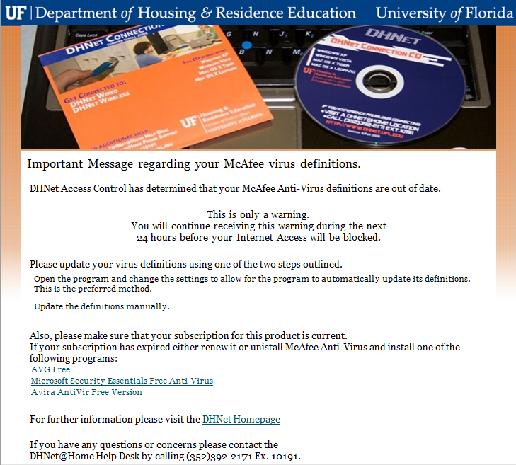

Slide 22
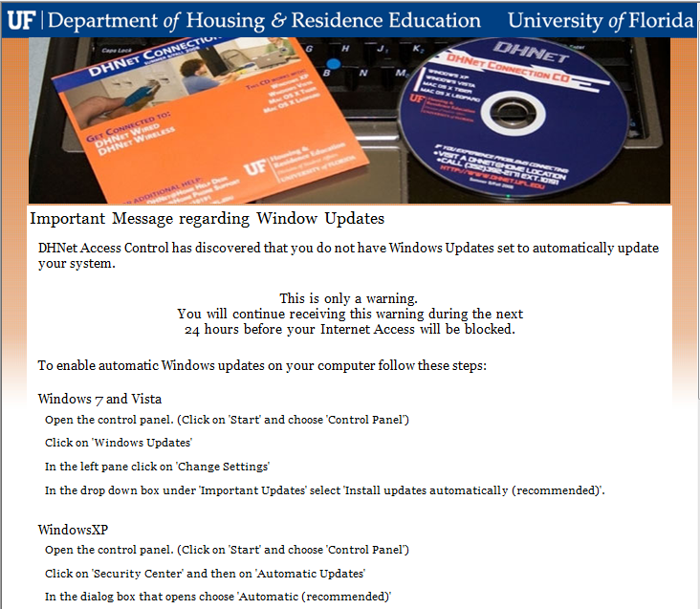

Slide 23
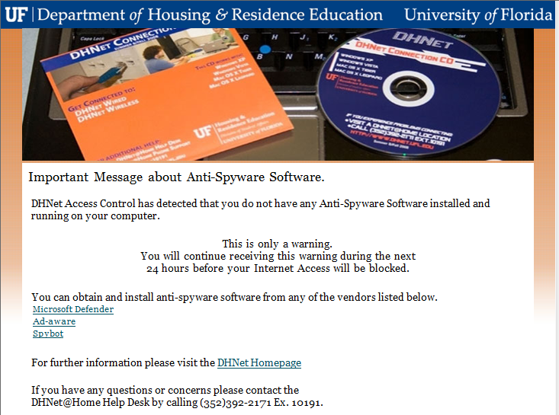

Slide 24
Impulse SafeConnect
Example of Windows Policy
Policy Key
  Quarantine, Immediate
P2P
  Quarantine, Immediate
Anti-virus
  Warning 1 Day, Warning 1 Day, Quarantine
OS updates
    Warning 1 Day, Warning 1 Day, Quarantine
Anti-spyware
  Warning 1 Day, Warning 1 Day, Quarantine

Slide 25
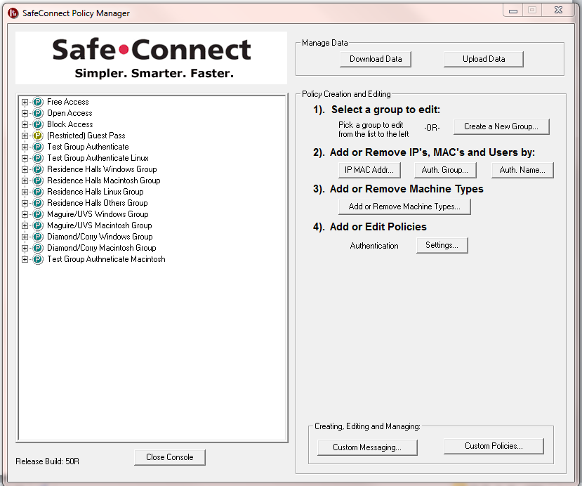
Management Console

Slide 26
Reporting Console

Slide 27
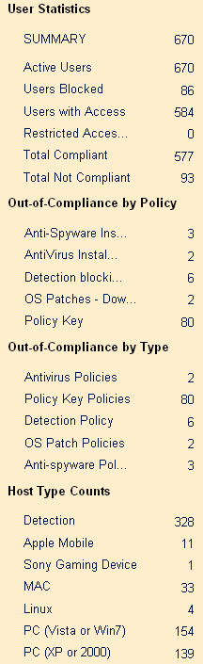
Real Time Reporting

Slide 28
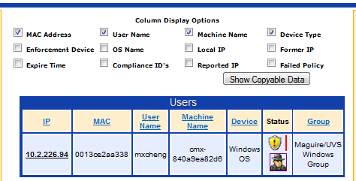
Anti Spyware

Slide 29
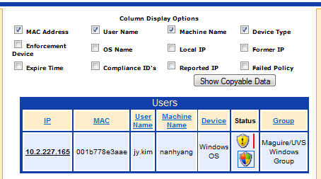
Anti-Virus

Slide 30
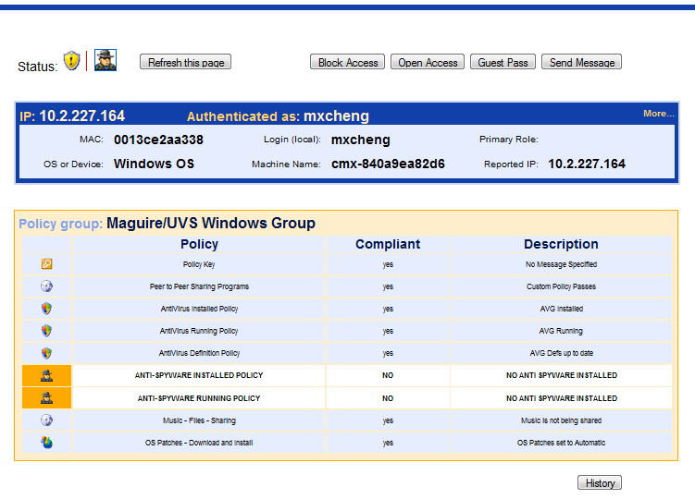
Open Access Per User

Slide 31
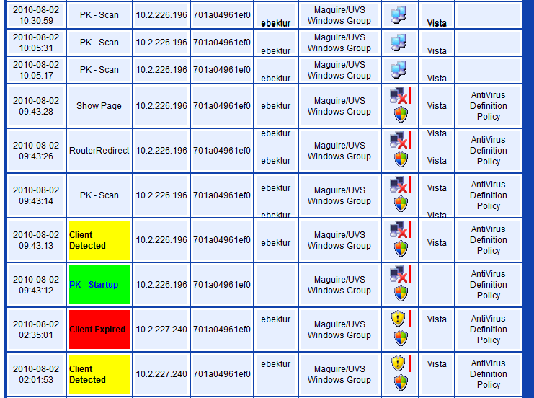
SafeConnect History

